Slide 1
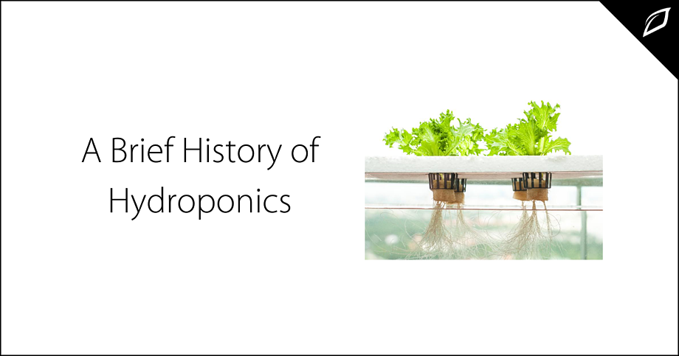
A Review on Project
STES’S SINHGAD ACADEMY OF ENGINEERING KONDHWA, PUNE 411048
IoT based Hydroponic System
Presented by :
Project group 48
- Komal Naphade(B018)
- Pranav Gavali(B046)
- Dhiraj Shelke(B071)
Guided by :
Prof. P. Nanaware

Slide 2
Outline
Introduction
Motivation
Problem Definition
Literature Survey
Software Requirements Specification
Hardware Requirements Specification
Project Scope
Project Timeline chart
Assumptions and Dependencies
Architecture
Mathematical model
Algorithms
Data Flow Diagram Level-0,
DFD Level-1,
DFD Level2.
UML Diagrams
Partial Implementation
Conclusion.

Slide 3
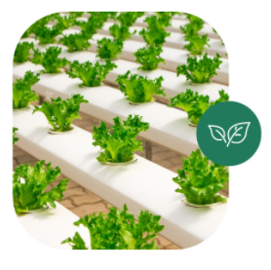
Introduction
Hydroponics is a technique of growing plants without soil and without the limitations of space and climate.
In the traditional farming system, plants depend on soil to obtain all nutrients needed for their growth.
In contrast, a hydroponic garden provides all of these nutrients without involving sunlight, soil, extra labour, allowing farmers to benefit from efficiencies and to reap large produce yields.

Slide 4
Photosynthesis process :
Carbon Dioxide + Water -> Glucose + Oxygen
6CO2 + 6H2O -> C6H12O6 + 6O2
There is no mention of “soil” anywhere in there and that’s all the proof you need that plants can grow without it.
Plants require 17 essential elements to grow and reproduce
The first three are Hydrogen, oxygen and carbon
Other 14 are:
Macro-Elements: Nitrogen, Phosphorous, Potassium, Calcium, Magnesium, Sulphur
Microelements: Iron, Manganese, Copper, Zinc, Boron , Chlorine, Molybdenum, Nickel

Slide 5
Nutrient Solutions
In Hydroponics, Nutrient control is easy
It consists of a nitrogen rich grow formula
A phosphorous and potassium rich bloom formula
And the results ?
Bumper crops of delicious fruits and vegetables every time.

Slide 6
Motivation
Have a Mobile & Dynamic setup
To design efficient systems in terms of water usage, and a higher crop yield.
Reduce inefficient and Destructive farming
To increase awareness relating to the benefits of Hydroponics.

Slide 7
Problem Definition
Every plant grown using open agriculture farming, ties up a certain amount of land for a long duration (usually through the growing season).
Agriculture uses lots of water.
Agriculture farming takes lot of time to produce outputs.

Slide 8
Literature Survey
Sr. No | Topic | Author | Year | Major Findings
1 | iPONICS: IoT Monitoring and Control for Hydroponics IEEE Conference | K. Tatas, A. Al-Zoubi Antoniou D. Zolotareva | 2021 | The system is composed of a specialized Wireless Sensor Network for monitoring the essential parameters for Hydroponics and control for the pump. It provides the user with a user friendly web-based tool to monitor his crops as well as being appraised by appropriate alarms and warnings. This greatly facilitates the observation of multiple hydroponics greenhouses with minimal effort and need for intervention.

Slide 9
Literature Survey
Sr. No | Topic | Author | Year | Major Findings
2 | Hydroponics System for Soilless Farming Integrated with Android Application by Internet of Things and MQTT Broker – IEEE Conference | Navneet K. Bharti Mohit D. Dongargaonkar Isha B. Kudkar Siuli Das Malay Kenia | 2019 | In this work monitoring several parameters is involved, which is achieved with basic sensors and one single micro-controller. Monitoring these parameters not only helps to keep a watch on the system but also data is used for further evaluation of the quality of the harvest for future scientific data analysis. Internet of Things is used to accumulate the data and store it on servers. An Android application can fetch this data, creating a more personalized setup and data. Many people are not aware of this kind of farming; Android application is a better platform to spread the knowledge than any other media

Slide 10
Literature Survey
Sr. No | Topic | Author | Year | Major Findings
3 | Automated Irrigation System Using a Wireless Sensor Network and GPRS Module - IEEE Transaction | Joaquín Gutiérrez, Juan Francisco Villa-Medina, Alejandra Nieto-Garibay, and Miguel Ángel Porta-Gándara | 2014 | The automated irrigation system hereby reported, consisted of two components wireless sensor units (WSUs) and a wireless information unit (WIU), linked by radio transceivers that allowed the transfer of soil moisture and temperature data, implementing a WSN that uses ZigBee technology. The WIU has also a GPRS module to transmit the data to a web Configuration of the automated irrigation system. WSUs and a WIU, based on microcontroller, ZigBee, and GPRS technologies.. The information can be remotely monitored online through a graphical application through Internet access devices

Slide 11
Literature Survey
Sr. No | Topic | Author | Year | Major Findings
4 | IoT Based Automated Hydroponic Cultivation System – IJAER Journal | Dr. Ponmurugan Sudharsan, Vargunan, Vignesh Raj , Selvanayagan | 2019 | In this study, the crops are grown without the use of soil, instead the nutrients from the soil are directly given to the crops by water reservoir. The adequate nutrients that are required by the plants are measured and added to the water reservoir so that the crops get enough nutrients from the water as equal as from the soil. By the intervention of IoT this whole hydroponic system can be automated. All the data from the hydroponic system are sent to the cloud data for the automation purpose. The health condition of the crops is continuously monitored with the help of data that are collected by the sensors and actuators.

Slide 12
Software Requirements Specification
Open Source Languages & Libraries
Arduino
AutoDesk for Creating model

Slide 13
Hardware Requirements Specification
pH Control
Horticulture Lighting( Grow Lights )
Pipes to transfer fluids
A Controller to control the System (Arduino)

Slide 14
Project Scope
100% Automation
PCB design and layout with sensor interfacing
Web integration
Mobile application design
Besides project scope, there are intangible skills we look to gain as well.

Slide 15
Project Timeline Chart
Analysis
Just the basic Survey of the Project and Study of Research Papers
Duration : 3 – 4 Weeks
Requirement
Gathering
Collection of all required components and firmware for the project
Duration : 1 Month
Design and Deployment
Proper project overall design by creating models before actual implementation
Duration : 3 – 4 Weeks
Implementation
Testing
Implementation of Project on the basis of requirement gathering and design models planned previously.
Duration : 1 – 2 Months
Testing the actual project on the basis of different aspects.
Duration : 1 Month

Slide 16
Assumptions and Dependencies
You’ll have access to all the resources you need to complete the project, both human and material.
Project team members will have the resources they need to complete their individual tasks on time, from specialized equipment and software down to electricity during working hours.
Personnel costs will not change during the project cycle.
Other material and resource costs will remain consistent throughout the project.
The overall cost of day-to-day operations will not increase.
All equipment will be in working condition through the project cycle.
Most important Dependency is the location where the system is built. It should be spacious enough.

Slide 17
Conclusion
Hydroponics is the effective technology for the places of the world having scarcity of infertile and arable land for cultivation of crops. Fresh products can also be harvested through hydroponics throughout the year as it is not like traditional cultivation practices.
Additionally technologies like Machine Learning, Artificial Intelligence, Deep Learning, etc. can help to boost this sector and help deploy it for millennials. As observed, we can conclude that using such technologies can help us increase crop yield over 70% and reduce the cost significantly ‘over-time’ as well.

Slide 18
Thank you !

